Slide 1
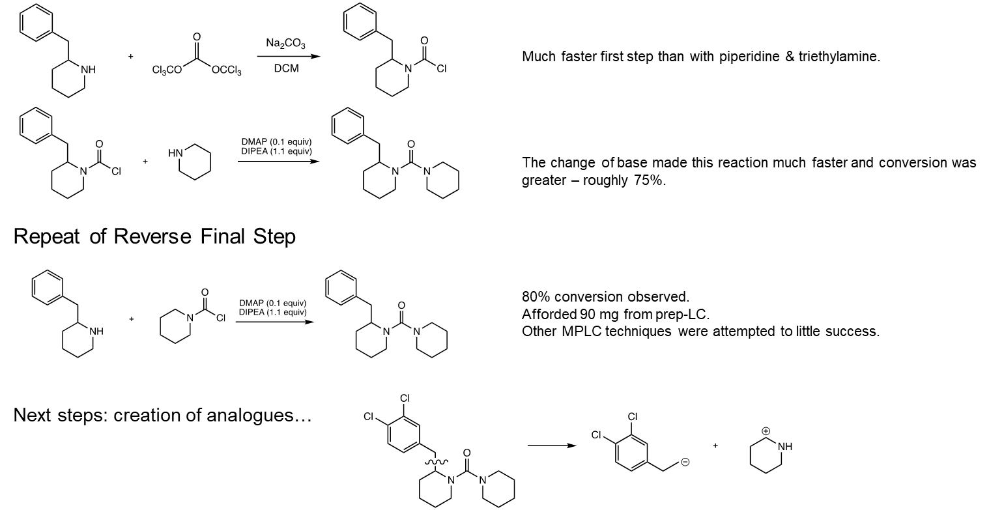
ABHD2i synthesis

